Slide 1
Inferring Binary Relation Schemas for Open Information Extraction
Kangqi Luo
2015-04-22

Slide 2
Content
Motivation
Approach
Evaluation & Demo
Error Analysis
Conclusion

Slide 3
Motivation
Make a better understanding for Open Information Extraction
TextRunner, ReVerb, ……
Sentences → Relation Instances
ReVerb: billions of <arg1, rel, arg2> triples
<Tom Brady, played in, National Football League>
<PDF, was developed by, Adobe Systems>
<Kalba, is a town in, the United Arab Emirates>
Notes:
[OK] First to introduce open information extraction. give a detail example.

Slide 4
Motivation
When group similar instances together…
……
<Elix Skipper, played in, the CFL>
<Tom Brady, played in, National Football League>
<Daniele De Rossi, played in, UEFA Champions League>
<Athlete, play in, Sport League>
Notes:
[OK] Conceptualize to Schema

Slide 5
Motivation
Provides Extra Information in Entity Disambiguation
“Granger played in the NBA”
Granger (US city)
Hermione Granger (film character)
Danny Granger (sportsman)
Stewart Granger (actor)
If we know the schema of “play in” <athlete, sport league>
QA
“what did Tom Cruise play in ?”
Better to be a film (<actor, play in, film>)

Slide 6
Motivation
Relation with multiple meaning
<X, die in, Y>, possible schemas:
<deceased person, location>
<deceased person, date/time>
Goal: Find all possible relation schemas for binary relation in Open IE system
Use Freebase type taxonomy to represent schema
Notes:
[OK]

Slide 7
Freebase Types as Schema
film
people
location
Domain
actor
person
place of birth
location
Type
place of birth
Entity
Barack Obama
Hawaii

Slide 8

Framework
ReVerb
RvSp
relation
tuples
relation
preferences
entity
names
type
taxonomy
Entity
Linking
Relation
Merging
Selectional
Associating
linked
tuples
relation
groups
Notes:
[OK]

Slide 9
Entity Linking
Map arguments to Freebase entities
< Elix Skipper (/m/05n8y), played in, the CFL(/m/0fnw5)>
Freebase provides aliases for one entity
New York City(/m/02_286): “New York City” “Big Apple” “NYC” “Empire City” …
Intuition: Word level fuzzy matching
Different words have different weights.
Notes:
[OK] abbreviation

Slide 10
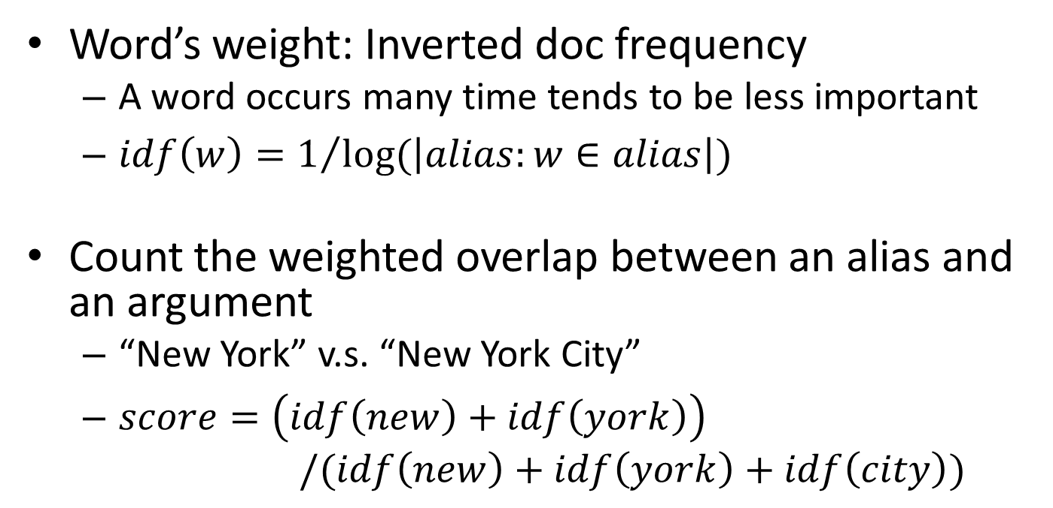
Entity Linking
Word’s weight: Inverted doc frequency
A word occurs many time tends to be less important
$idf\left(w\right)=1/{log⁡(\left|alias:w∈alias\right|)}$
Count the weighted overlap between an alias and an argument
“New York” v.s. “New York City”
$score=\left(idf\left(new\right)+idf\left(york\right)\right)$ $/(idf\left(new\right)+idf\left(york\right)+idf\left(city\right))$
Notes:
[OK] Talk about additional restrictions in talking

Slide 11
Relation Merging
Group relation instances with the same relation pattern.
Recognize syntactically equivalent patterns
Exactly the same meaning, but differ in tense
Resolve tense & lemmatization
“resigned as” “recently resigned as” “had finally resigned as” … → “resign as”

Slide 12
Selectional Associating
Given the group of relation instances, compute the association score of <t1, t2>.
Leveraging Freebase types of instances.
One entity has multiple types
New york city: location, citytown, film subject, administrative division, travel destination ……

Slide 13
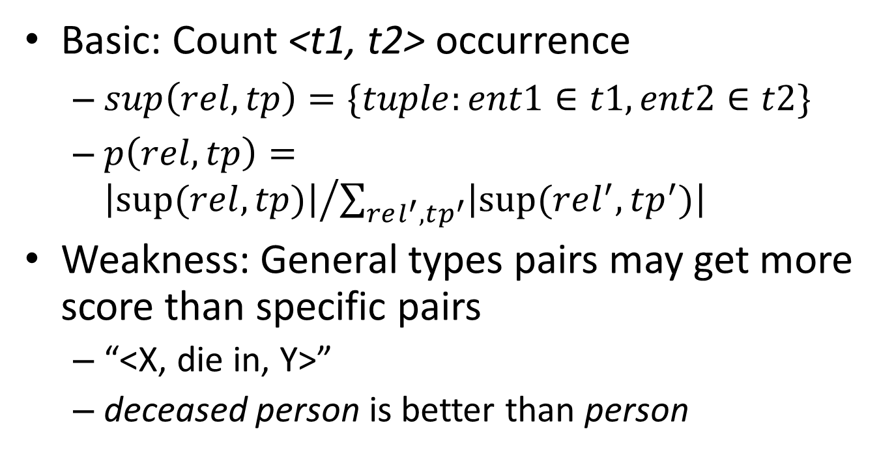
Selectional Associating
Basic: Count <t1, t2> occurrence
$sup\left(rel, tp\right)=\{tuple:ent1∈t1,ent2∈t2\}$
$p\left(rel, tp\right)={\left|sup⁡(rel,tp)\right|}/{\sum_{rel^{′},tp^{′}}{\left|sup⁡(rel^{′},tp^{′})\right|}}$
Weakness: General types pairs may get more score than specific pairs
“<X, die in, Y>”
deceased person is better than person
Notes:
Occurred too much time with other relations, otherwise, we may find a lot of <person, location> relation pairs
The most preferred type pairs shouldn’t be too general.
X: deceased person is better than person,author,……

Slide 14
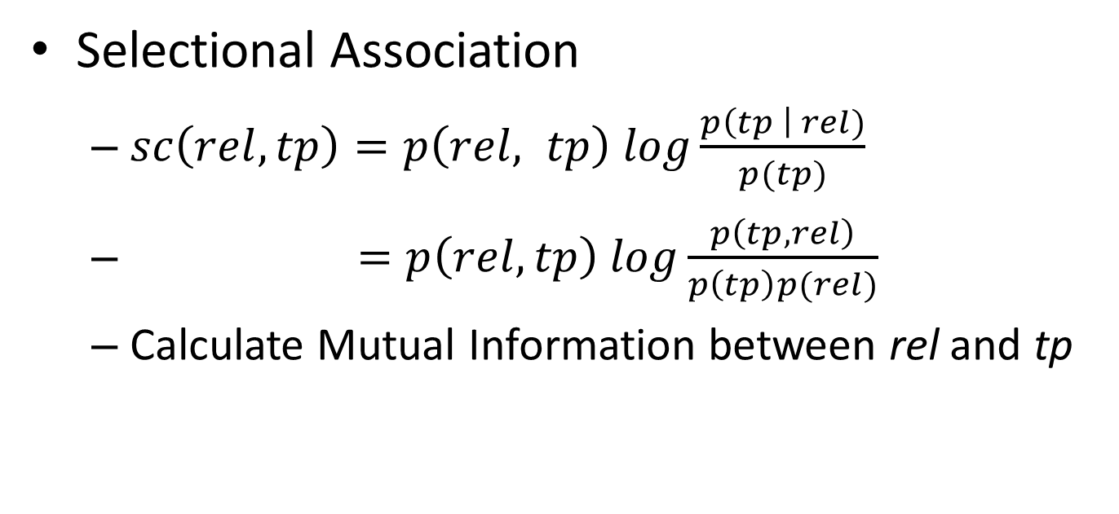
Selectional Associating
Selectional Association
$sc\left(rel, tp\right)=p\left(rel, tp\right) log\frac{p\left(tp \right| rel)}{p(tp)}$
$=p\left(rel, tp\right) log\frac{p\left(tp,rel\right)}{p\left(tp\right)p(rel)}$
Calculate Mutual Information between rel and tp
Notes:
posterior prob. / prior prob. (measuring the change given the rel)
MI: measure the dependence of two variables
independent with each other? 0. dependent: p(tp,rel)>p(tp)p(rel)

Slide 15
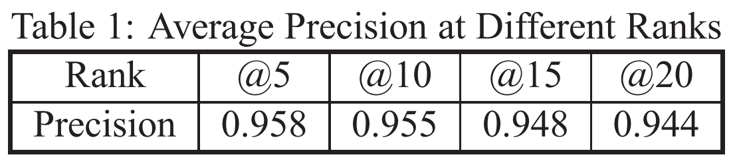
Evaluation
Collect 176,325 binary relations in ReVerb
Randomly Pick & Human Judge

Slide 16
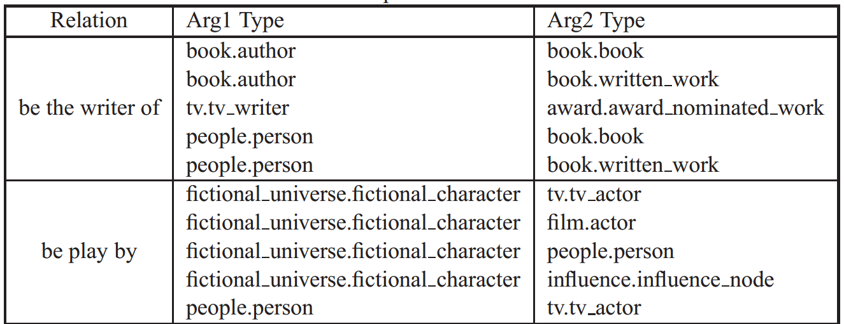
Evaluation

Slide 17
Demo Page
http://202.120.38.146:8080/rvsp/

Slide 18
Error Analysis
Entity Linking Problem
Simple writing may cause problem
<Utah, played in, the Mountain West Conference>
“San Diego State and Utah play in the Mountain West Conference, which is distinguished ……”
University of Utah
Utah info is mentioned in the other part of the article
Notes:
you can search it in the web

Slide 19
Error Analysis
Type Distribution Problem
“<London, is the capital of, United Kingdom>”
UK: country, location, film subject, …
London: city, location, university campus, TV location
We treat these types equally
Entity’s type disamb. is another task
about 2000 types in Freebase
Notes:
[OK] An entity has several types, but given the context, it’s biased

Slide 20
Error Analysis
Duplicated Schema Problem
Result for “be the capital of”
Arg1 | Arg2 | score
location.citytown | location.statistical_region | 2128.938
location.citytown | location.dated_location | 2114.4167
location.statistical_region | location.location | 1894.7739
location.dated_location | location.location | 1877.0101
location.statistical_region | location.dated_location | 1825.589
location.statistical_region | location.statistical_region | 1823.6035
Notes:
[OK]

Slide 21
Conclusion
Extract multiple meanings for one relation
Model the preference of args simultaneously
Data driven approach
Find entity’s representative type is crucial

Slide 22
Thanks for listening!

